Slide 1
Why Go?
Adam Szecówka
SAP Labs Poland

Slide 2
Agenda
Go success stories
Why?

Slide 3

Go Success Stories

Slide 4

Go Success Stories
“k8s is an open-source system for automating deployment,
scaling and management of containerized applications”
Notes:
k8s is an open-source system for automating deployment, scaling and management of containerized applications

Slide 5

Go Success Stories
CF – the cloud application platform.
CF makes it faster and easier to build, test, deploy and scale applications
Notes:
CF – the cloud application platform.
CF makes it faster and easier to build, test, deploy and scale applications
Go, Java, Ruby

Slide 6

Go Success Stories
“InfluxDB is meant to be used as a backing store for any use case
involving large amounts of timestamped data,
including DevOps monitoring, application metrics,
IoT sensor data, and real-time analytic”
Notes:
InfluxDB is meant to be used as a backing store for any use case involving large amounts of timestamped data, ncluding DevOps monitoring, application metrics, IoT sensor data, and real-time analytics.”

Slide 7

Go Success Stories
etcd is a distributed reliable key-value store
for the most critical data of a distributed system
Notes:
etcd is a distributed reliable key-value store for the most critical data of a distributed system

Slide 8

Go Success Stories
NATS Server is a simple, high performance open source messaging system
for cloud native applications, IoT messaging, and microservices architectures
Notes:
NATS Server is a simple, high performance open source messaging system for cloud native applications, IoT messaging, and microservices architectures

Slide 9




Go Success Stories
Notes:
Most cloud providers has at least part of their infra written in Go.
In 2014, Donnie Berkholz, called Go a new language for the cloud infrastructure.

Slide 10
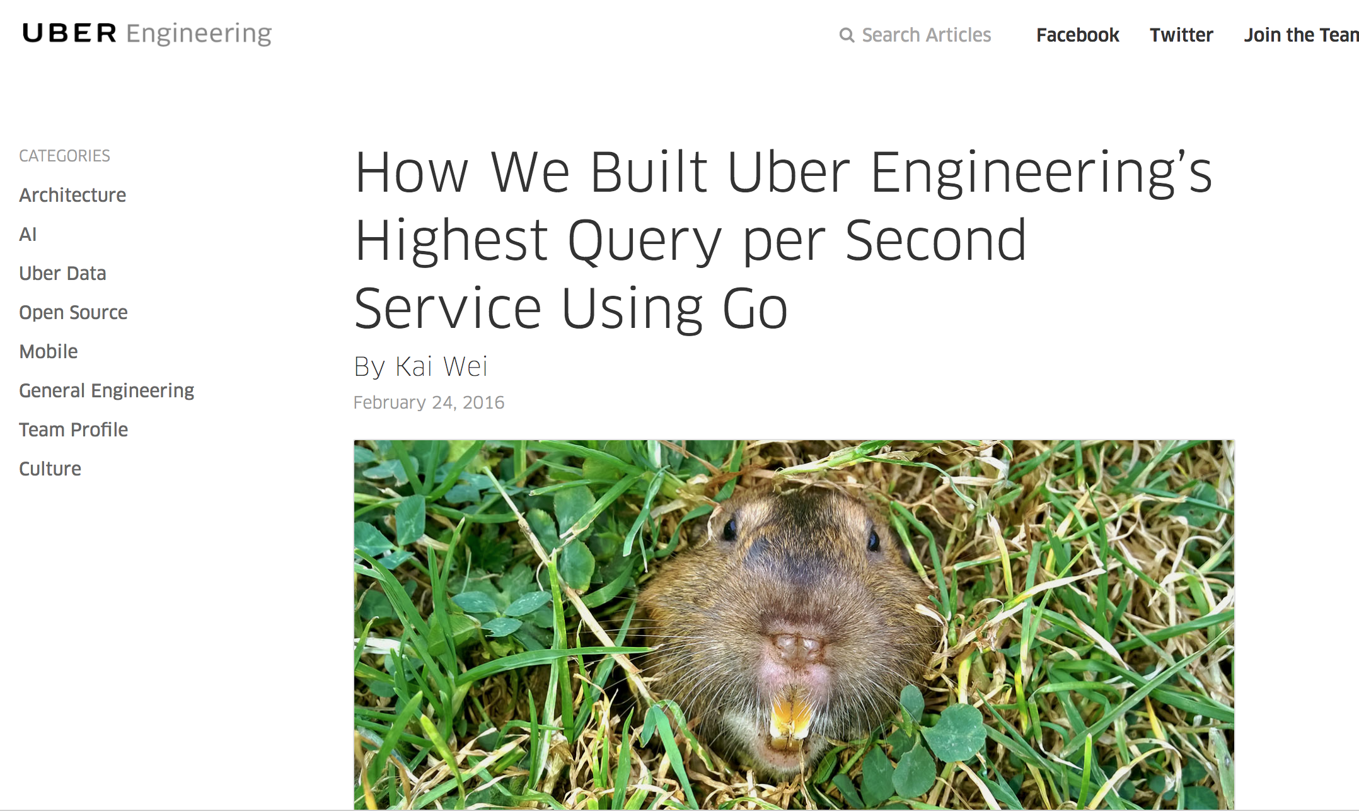
Go Success Stories

Slide 11

Why?
https://bpimediagroup.com/2017/why/
Notes:
What are the strengths of the language?

Slide 12
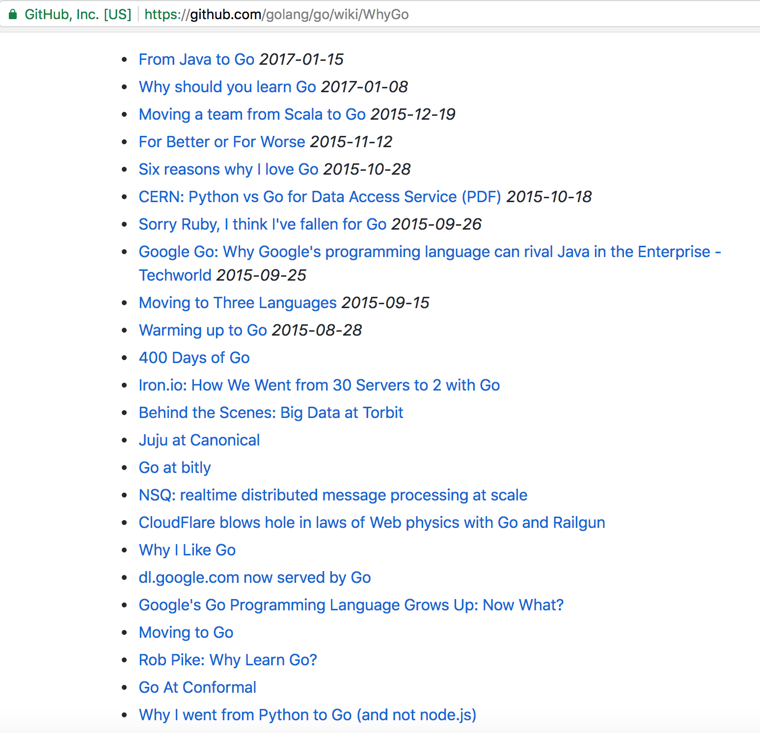
Why?
Notes:
I have found interesting conclusions
There are 4 factors that appear most frequently.

Slide 13
Simplicity

Slide 14
Simplicity
“Less is exponentially more”
Simple syntax
Easy to learn
Orthogonality
Go does not compete on a features
Notes:
Less is exponentially more
Syntax similar to other languages
Easy to learn – recruitment
Jim Plush, Scala
Orthogonality
Not compete on features, f hurts readability and add complexity.

Slide 15
Standard library
Notes:
Python 1991, Java 1995, Go 2009
Great packages for network, test, benchmarks

Slide 16
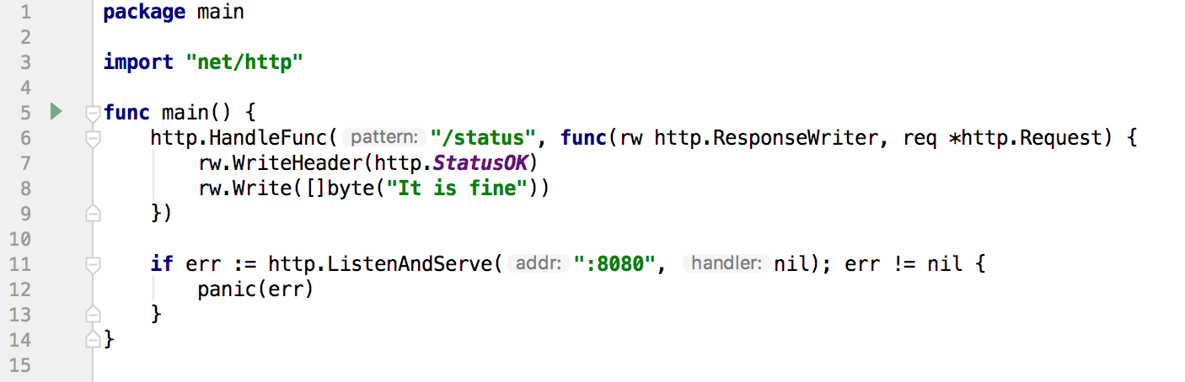
Standard library - HTTP
Compilation time: <1s
Response time: ~260us
Memory usage: 1.7MB
Notes:
net/http
no ext dependecies
Community use std library

Slide 17
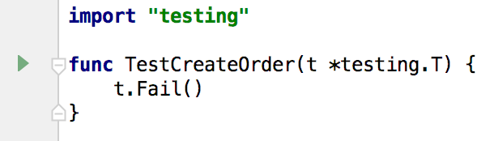
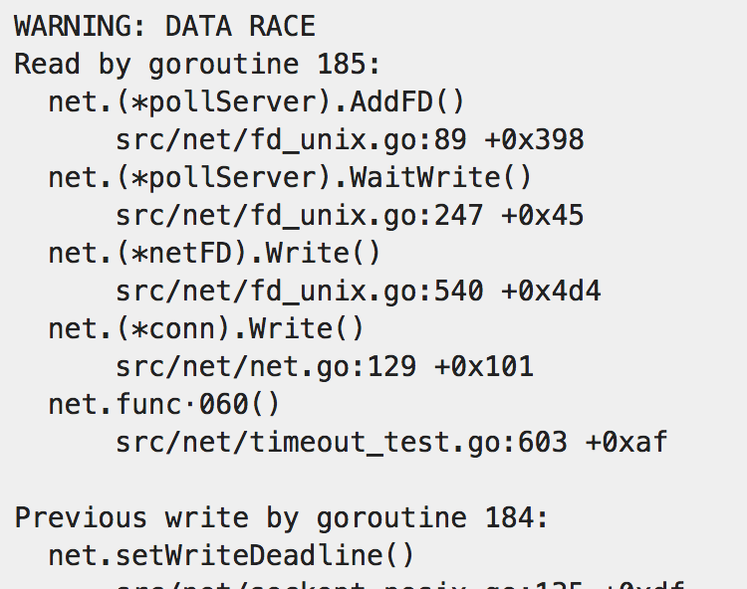
Standard library - Tests
Go test flags:
count
race
https://golang.org/doc/articles/race_detector.html​
Notes:
Count, race

Slide 18
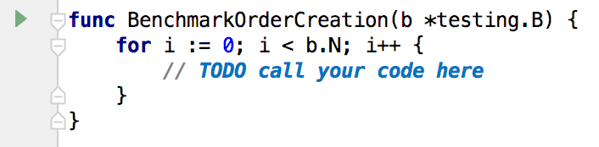
Standard library - Benchmarks
Notes:
Count, race

Slide 19
Concurrency

Slide 20
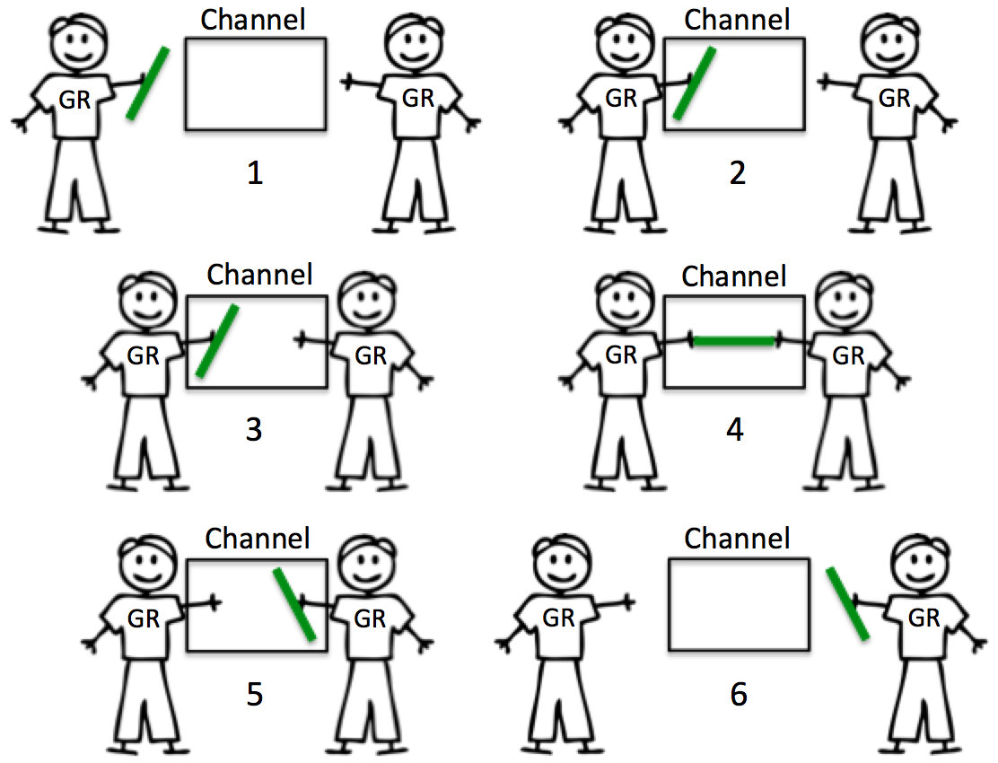
Concurrency
Goroutines vs threads
“go” keyword
Channels
“Do not communicate by sharing memory;
instead, share memory by communicating”
https://stackoverflow.com/questions/39826692/what-are-golang-channels-used-for​
Notes:
Goroutine: stack a few kB, 3 CPU instructions
Thread: 90 us, stack 512 kB
We can create thousands of goroutines
Threads limitations (it takes ages, os limit per program)
Go keyword

Slide 21
Stability and
development

Slide 22
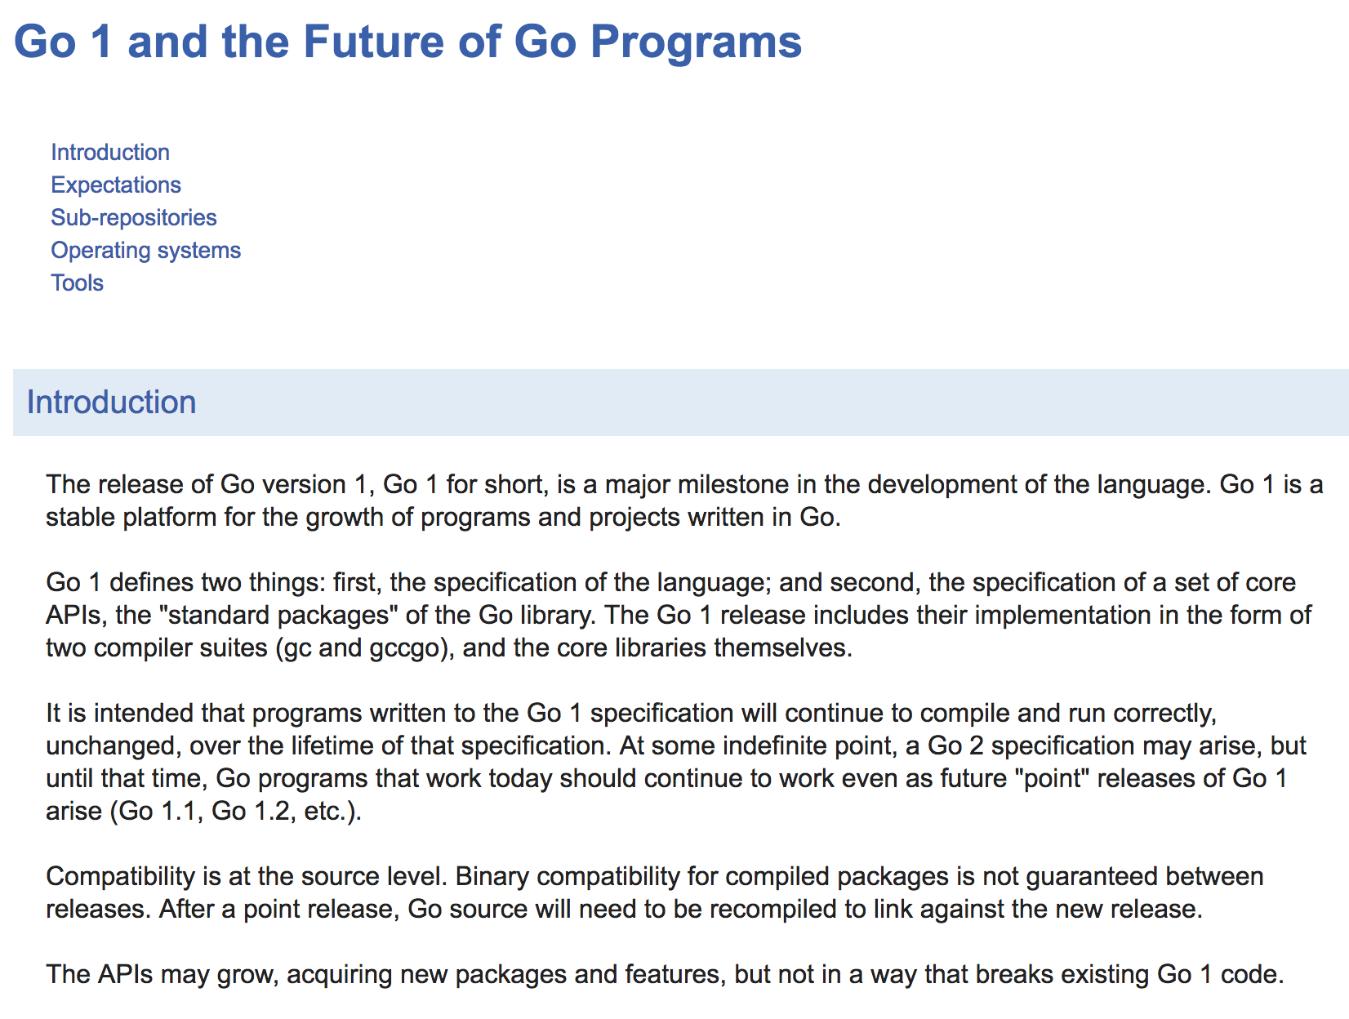
Stability and development
https://golang.org/doc/go1compat​
Notes:
Promise to be backward compatible – it is important from business perspective

Slide 23
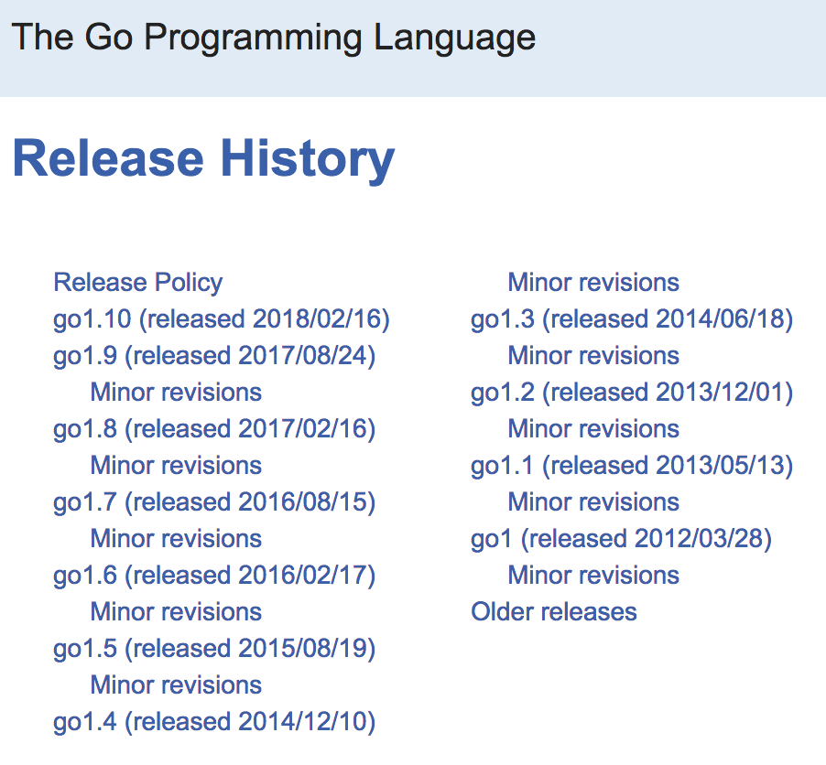
Stability and development
https://golang.org/doc/devel/release.html​
Notes:
Fast release cycle

Slide 24
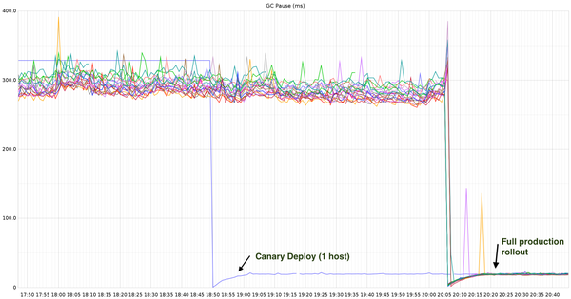
Stability and development
Go 1.5
https://twitter.com/brianhatfield/status/767812346760859648​
Notes:
1.5: 300ms to less than 100ms

Slide 25
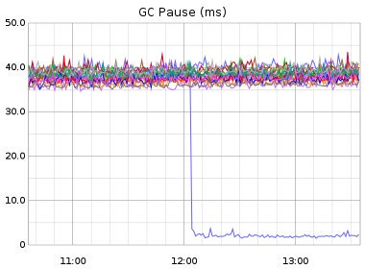
Stability and development
Go 1.6
https://twitter.com/brianhatfield/status/767812346760859648​
Notes:
1.6 -> less than 10 ms

Slide 26
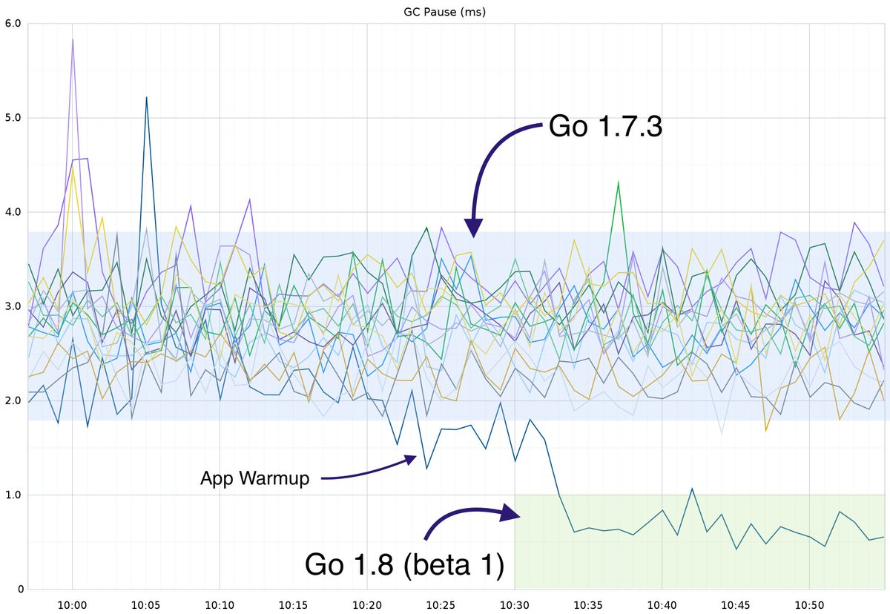
Stability and development
https://twitter.com/brianhatfield/status/767812346760859648​
Notes:
1.7: 3-4ms, 1.8: 1ms

Slide 27
Stability and development
Go 1.10 adds cache for test results
Terraform: 3min → 40s
Notes:
In Go 1.10 cache for test results was added.
- Terraform 40s instead of 3 min

Slide 28
Summary
Go strengths:
Simplicity
Great standard library
Concurrency
Stability and development
But:
No silver bullet
Notes:
Plenty of great features
No silver bullet, context is important
Go has no generic types
Encourage all of you to give it a try

Slide 29
Thank you.
Adam Szecowka
SAP Labs Poland
adam.szecowka@sap.com
Notes:
twitter, my email, or approach me at SAP booth

